Slide 1















Travellour
A DATABASE BASED APPLICATION FOR TRAVEL AGENTS
Submitted By: Ayushman Behera
Registration Number: 12301257
Roll Number: 44
Institution: Lovely Professional University

Slide 2
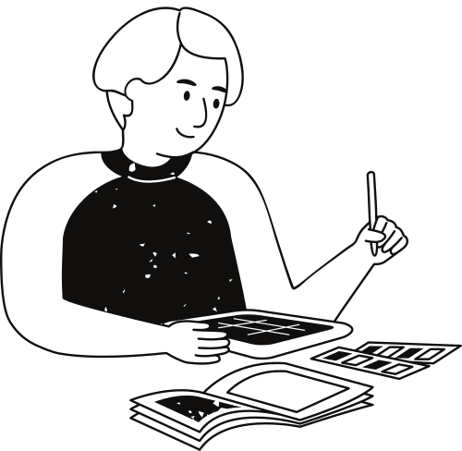
Introduction
Travel planning is often challenging due to fragmented information and complex booking processes.
Travellour is a Python-based GUI application that provides:
Seamless booking of flights, trains, buses, cabs, and hotels.
Destination insights and curated tour packages.
A user-friendly platform to enhance the travel experience.
Goal: To simplify and optimize travel management for agents and consumers.

Slide 3
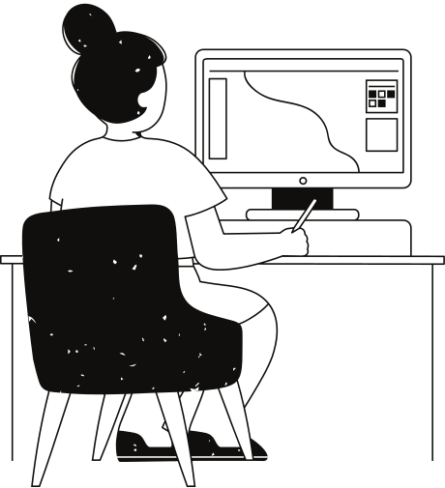
Objectives
Travellour aims to:
Provide destination information with structured details.
Offer curated tour packages tailored to customer preferences.
Facilitate customized travel itineraries for self-management.
Enable seamless bookings across multiple services on a single platform.
Enhance user experience through a friendly and visually appealing interface.

Slide 4
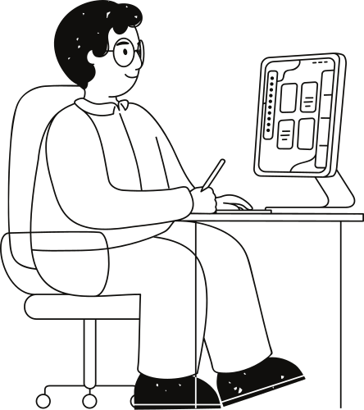
Scope
The application includes:
Main Interface: Central navigation for bookings and information.
Tour Packages: Predefined itineraries with descriptions, costs, and facilities.
Destination Information: Insights into top tourist attractions.
Booking System: Integrated platform for flights, trains, buses, cabs, and hotels.
Outcome: Streamlined travel planning and management for agents and users.

Slide 5

Application Tools
Programming Language: Python for flexibility and scalability.
IDE: PyCharm for efficient development and debugging.
Libraries Used:
Tkinter: GUI design.
Ttkbootstrap: Modern themes and styles.
Pillow: Image processing.
Datetime: Handling travel schedules.
Database: SQLite for lightweight, fast data storage.
Version Control: Git for systematic project tracking.

Slide 6
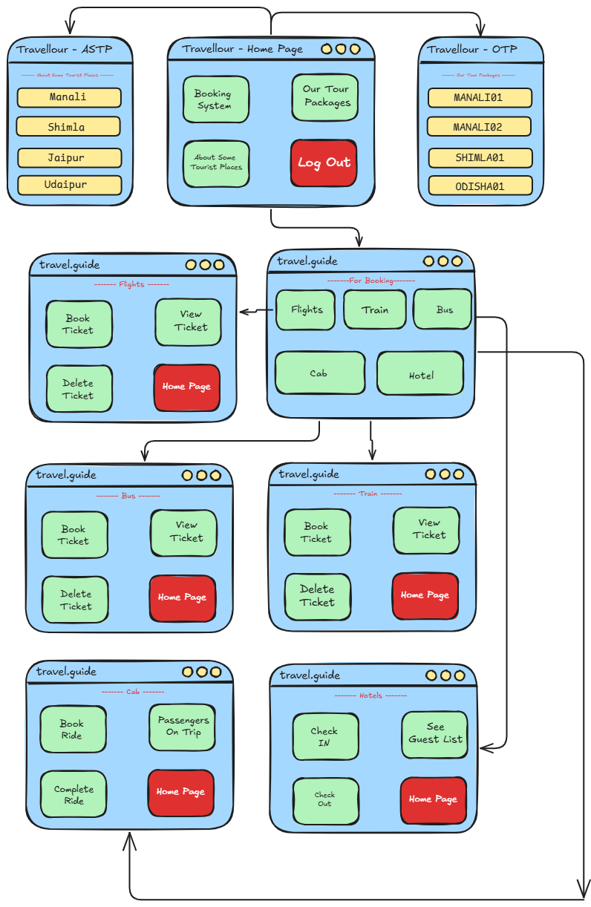
FLOWCHART

Slide 7
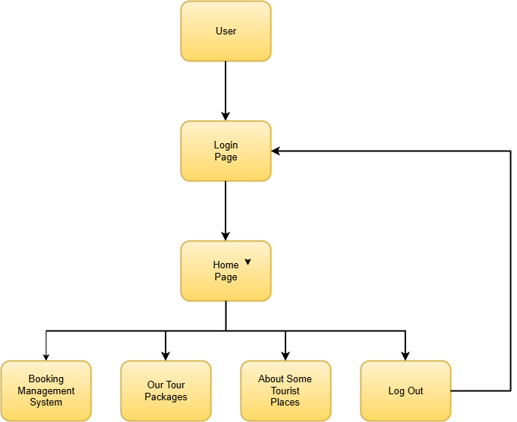
Level 0 DFD

Slide 8
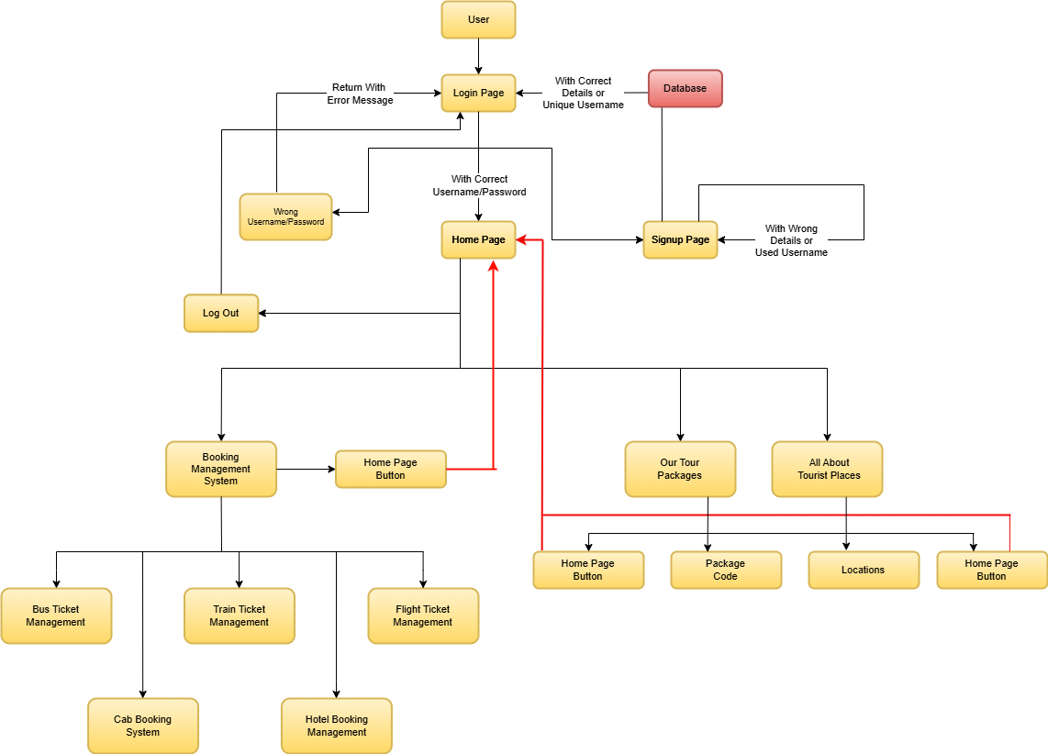
Level 1 DFD

Slide 9
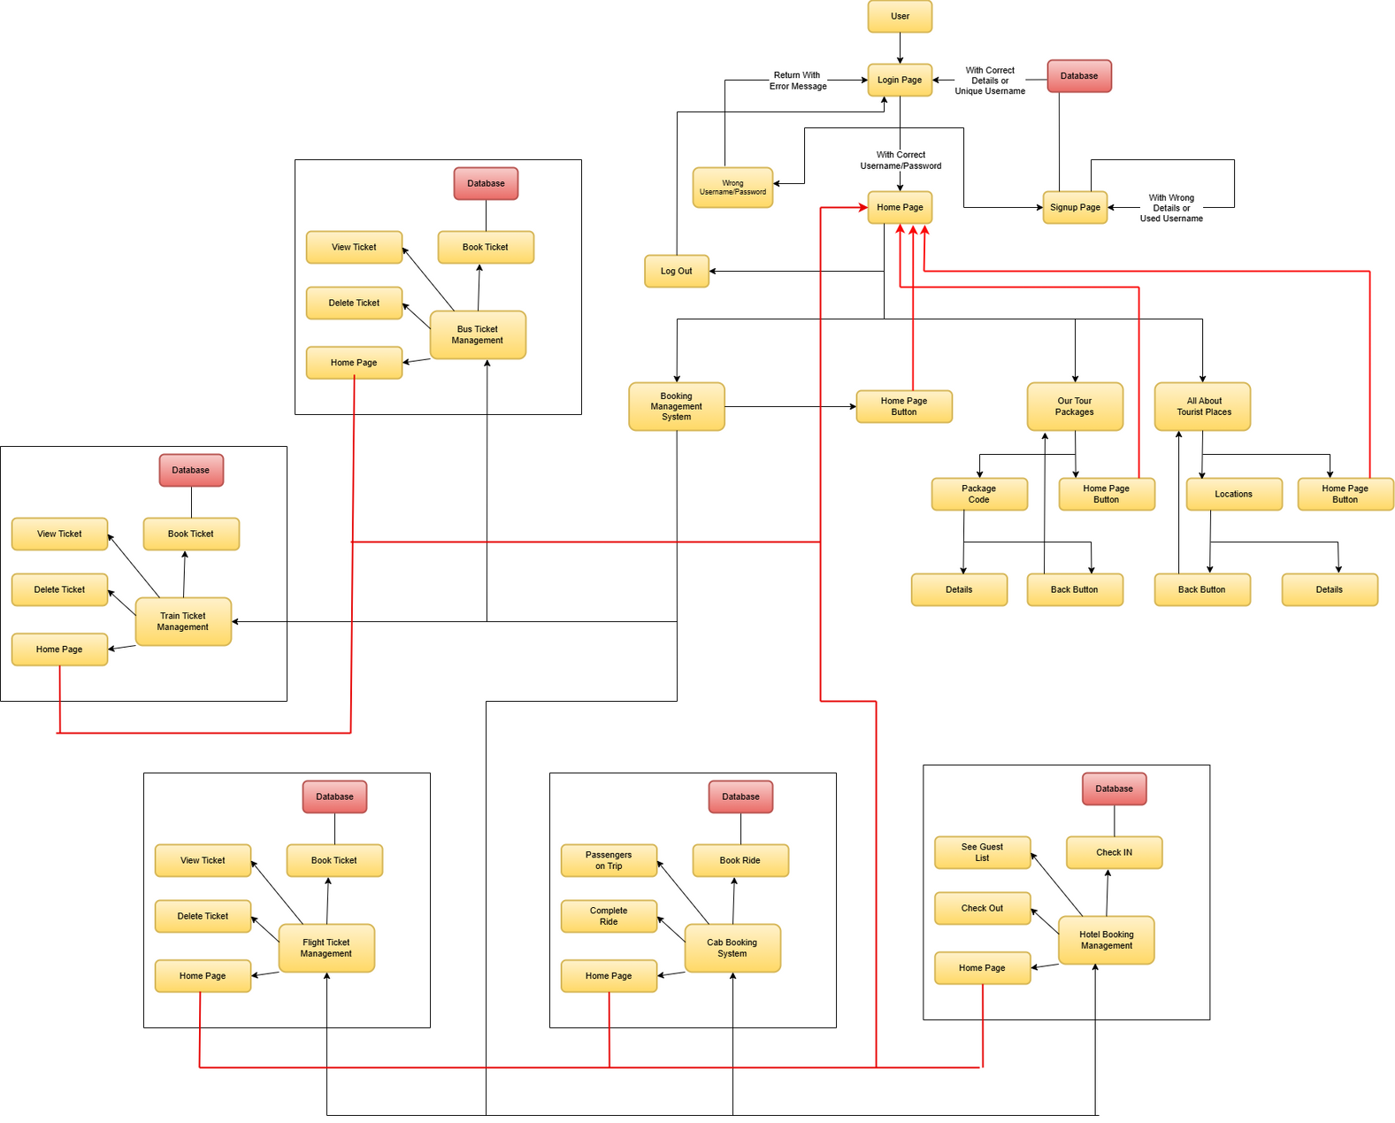
Level 2 DFD

Slide 10
Project Demonstration and Simulation

Slide 11

Conclusion
Achievements:
Unified platform for travel planning and management.
Simplified logistics for agents and users.
Real-time responsive and user-friendly design.
Future Enhancements:
Personal profiles and real-time updates.
Integration of online payment systems.
Enhanced personalization for itineraries.

Slide 12
Thank You!
Created and Presented by Ayushman Behera

